Slide 1
EMERGENCY ESCAPE BREATHING DEVICE
EmSCAPE
Date
Responsible, place

Slide 2
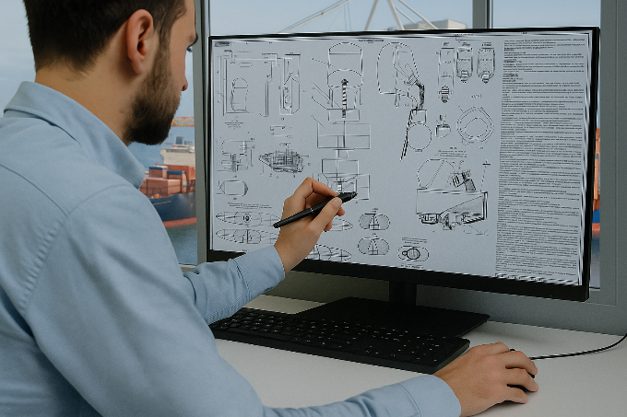
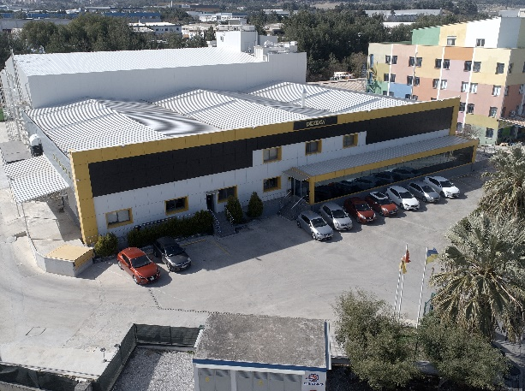
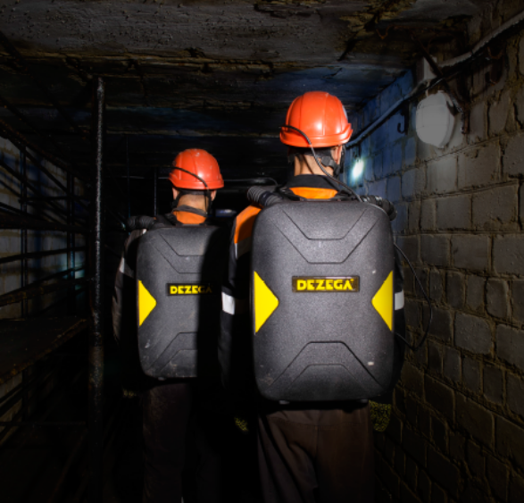
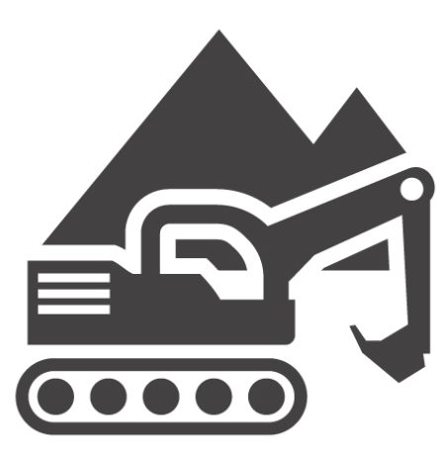

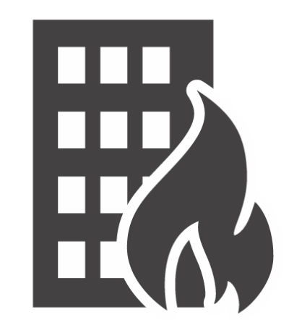
SINCE 1966 WE PROVIDE OXYGEN TO LIVE
INNOVATE
DESIGN
DEVELOP
MANUFACTURE
TEST
SUPPLY
mining
tunneling
ships
high-rise
toxic gases / oxygen deficiency

Slide 3
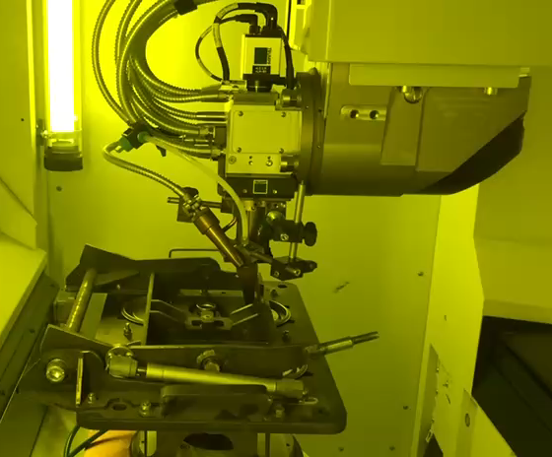
BUILT ON TRADITION, POWERED BY INNOVATION
Deep Mining Heritage
State-of-the-Art Facility
Decades of expertise in the most demanding underground environments, serving the mining industry with unwavering commitment
Cutting-edge automated manufacturing plant combining precision engineering with advanced production technology
EmSCAPE EEBD
Revolutionary respiratory protection engineered from years of real-world experience in the harshest working conditions
Notes:
For SOLAS:
EmSCAPE the only SOLAS-certified Chemical oxygen EEBD that combines the longest duration (30 min) while escaping and 3-times longer duration while waiting for rescue (90min) on the market with maintenance-free reliability within 10 years, compact design, light weight (2,2 kg) and clear communication by half mask— at a competitive price. All the benefits of compressed air and oxygen devices in one smart escape solution.
We combined our experience in the mining industry since 1966 and created together with end-users the new EEBD which meets all personal protection equipment and Maritime regulation, as well as wishes and requirements from the end-users. Simple intuitive donning procedure with automatic starter allows the unit to escape in case of emergency and fire at: ships, oil and gas facilities, high rise buildings and facilities with confined spaces, hospitals, hotels, elderly houses etc. as well as spare device for firefighters.

Slide 4
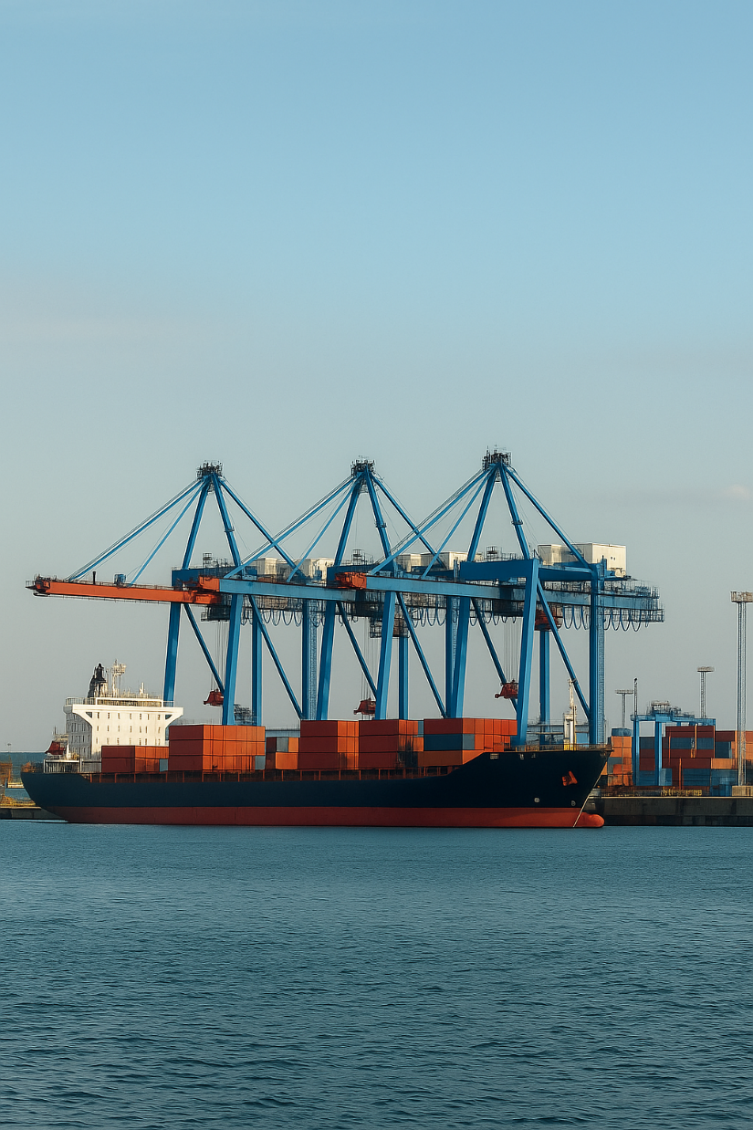
KO2 TECHNOLOGY
2КО₂ + СО₂ = К2СО3 +3/2О₂ 2КО₂ + Н₂О = 2КОН + 3/2О₂ 2КОН + СО₂ = К2СО3 +Н₂О
Safe
Reliable
Engineered with robust safety approach and fail-safe mechanisms for secure industrial operations
Proven performance consistency with minimal downtime across demanding production environments
Long Lasting
Built for durability with extended service life and maintenance-free requirements
Notes:
2КО2 + СО2 = К2СО3 +3/2О2 + 180 kJ;
2КО2 + Н2О = 2КОН + 3/2О2 + 39 kJ;
2КОН + СО2 = К2СО3 +Н2О + 141 kJ;

Slide 5
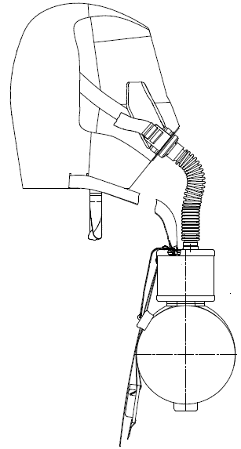
EmSCAPE OPERATING PRINCIPLE
01
Once EEBD is activated, starter generates oxygen
02
During exhalation gas goes to the cartridge
03
CO₂ and moisture are absorbed and O₂ emits
04
Surplus breathing gas is released via relief valve
05
During inhalation breathing gas goes backwards
06
Breathing gas is enriched with O₂ in cartridge and cooled in heat and moisture exchanger.
The absorption of CO₂ and production of O₂ by KO₂ is exothermic (producing heat). This temperature increase will be felt by the user on the casing and in the inhaled gas.

Slide 6
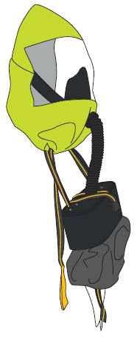
DEZEGA EmSCAPE TECHNICAL DATA
Meets the requirements of MED; SOLAS 74 Reg.II-2/13; ISO 23269-1
Rated duration at 35 l/min 30 min
Rated duration at rest 90 min
Temperature of inhaled gas, max 50 ⁰C
Breathing resistance, max 1,0 kPa
Average CO₂ content 1,5%
Weight of escape hood in box 2,35 kg
Weight of escape hood in bag 2,15 kg
Weight of working part 1,9 kg
Shelf life 10 years

Slide 7
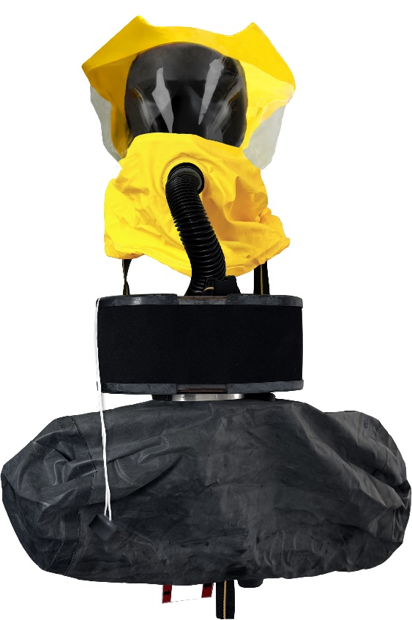
EmSCAPE EEBD
DURABLE
SIMPLE
RELIABLE
Intuitive donning procedure
Applied solutions from tough mining conditions
10 years maintenance free

Slide 8
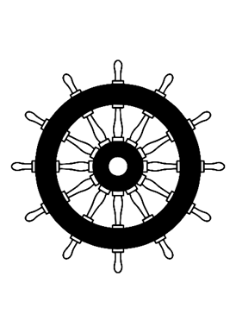
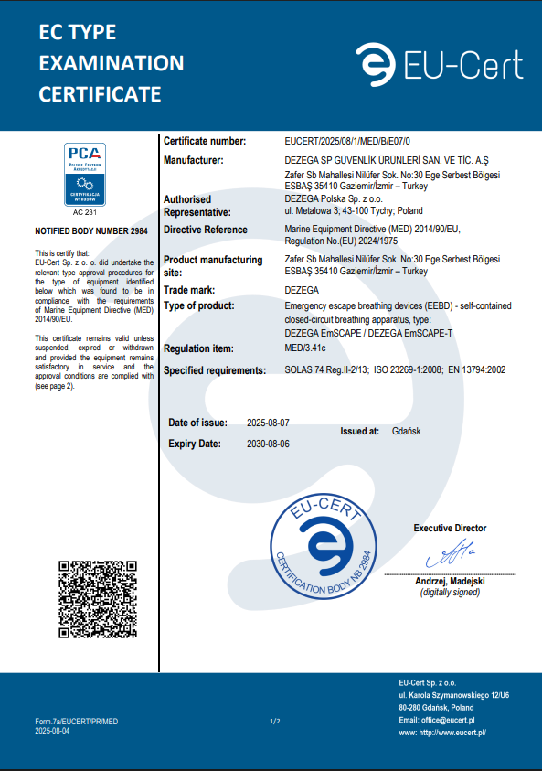
EmSCAPE MAIN DATA
SOLAS, MED, PPE approvals
Protection against toxic gases
Automatic starter
Breathing gas on demand
Work at oxygen deficient atmospheres
2984

Slide 9
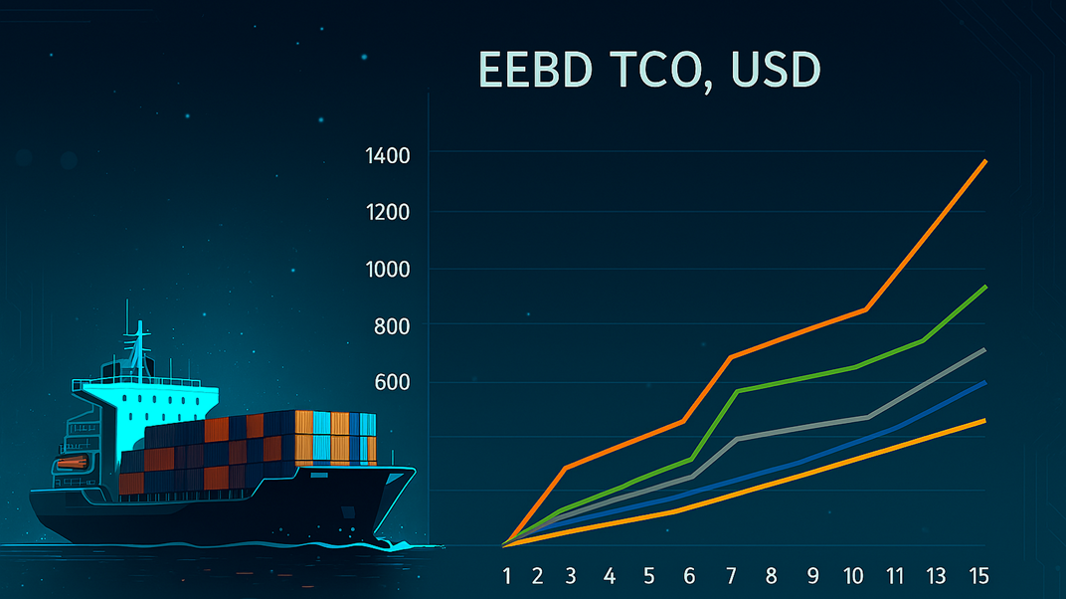
LOWER TCO
Simple implementation due to the small size, lightweight and packaging
Total cost of ownership is much lower than compressed oxygen or compressed air which require periodical maintenance of high pressure components
Same TCO as for other KO2 EEBD but with longer duration time
EmSCAPE, SEMMCO, Chinese EEBD, EEBD, Ocenco

Slide 10

NO SERVICE COST
Just simple visual inspection
Service easiness
  No high pressure components and hydro test
  No refill
  No weight check

Slide 11
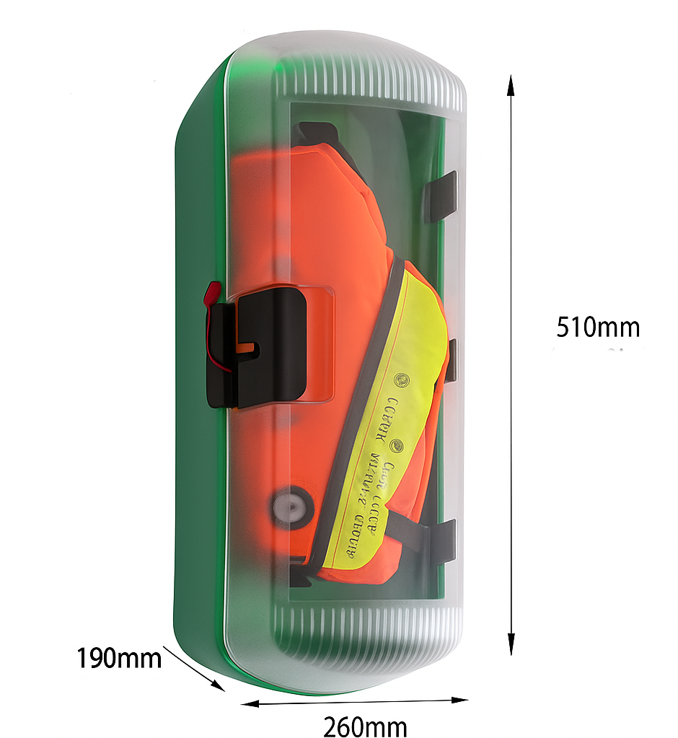
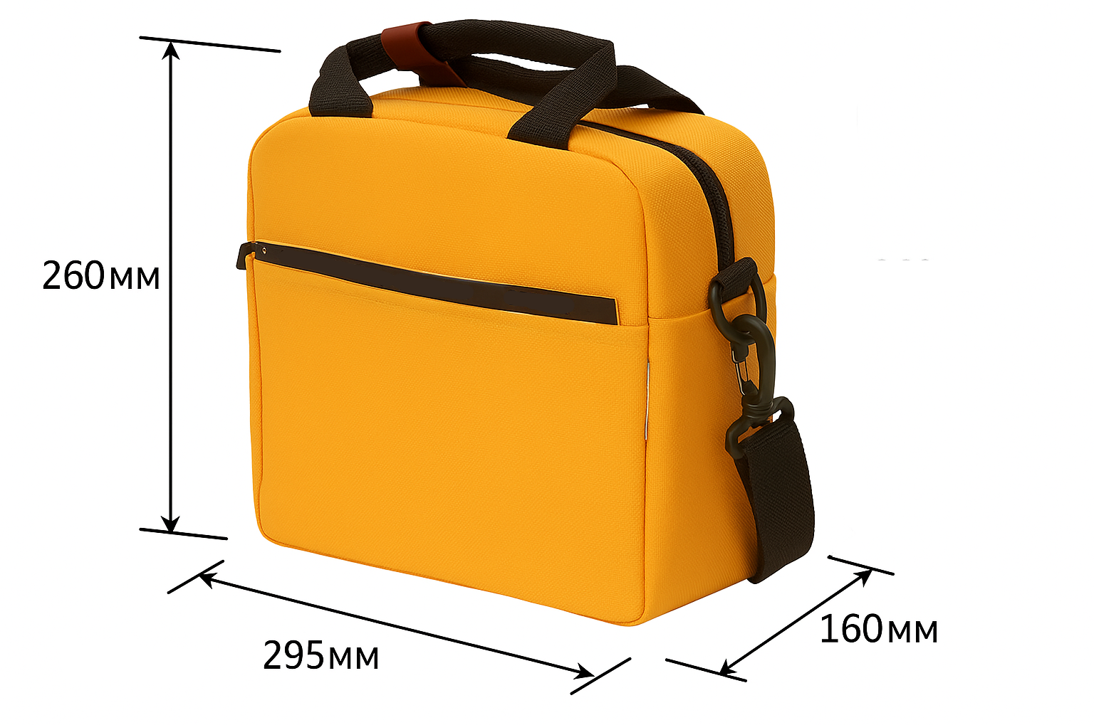
TCO – COMMISSIONING SIMPLICITY
Compact size device easy to install in “restricted spaces”
Availability of mounting bracket
Ready to use from factory box
Availability of training device for training and drills (no recharge, no maintenance)
Product available in stock

Slide 12
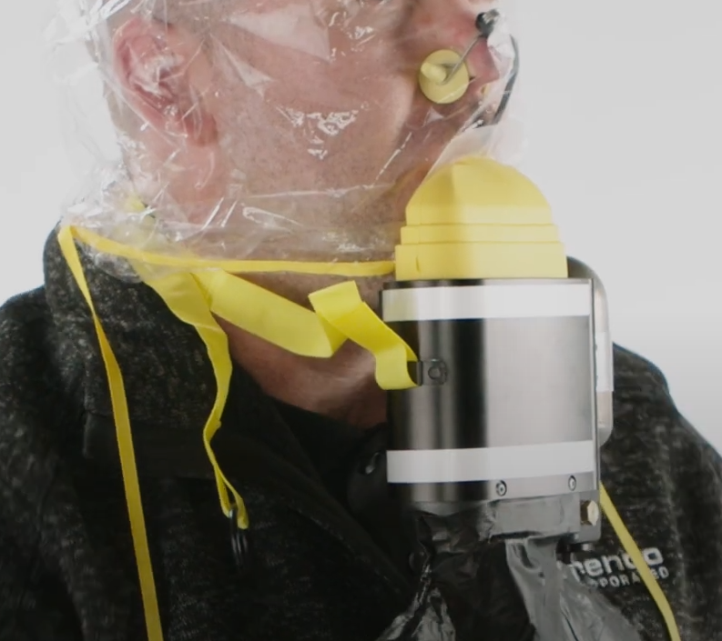
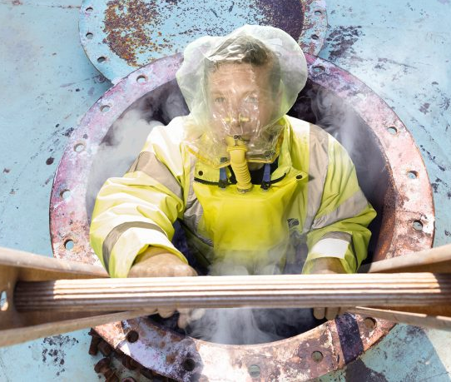
ERGONOMICS - COMMUNICATION
Communication during escape due to the half mask face piece

Slide 13
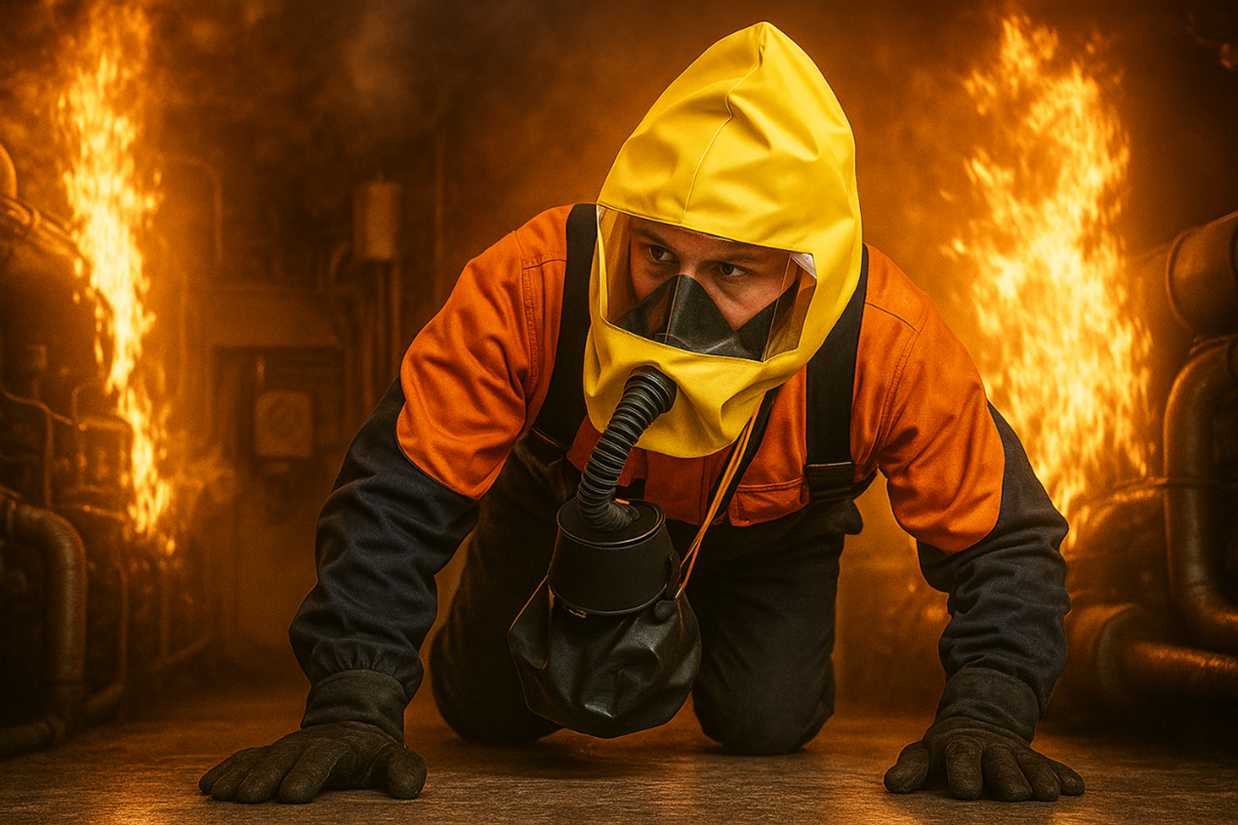
ERGONOMICS - MOBILITY
Free head movement
Low risk of EEBD damaging
Low risk of hose entanglement
Free hands during walking, or crawling

Slide 14

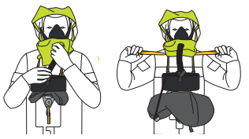
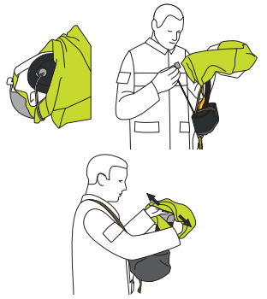
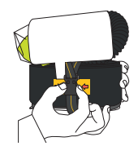
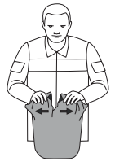
ERGONOMICS - DONNING
5. Leave the emergency area.
4. Adjust the hood, start breathing
3. Remove the plug, put the hood
2. Unclip the quick-release buckle
1. Open the sealed package
Video: https://youtu.be/r_C4nm6U6RE?si=3gVQIe0s3pMruTIT

Slide 15

SUMMARY
03
10 years maintenance free shelf-life
04
Smaller size and weight
05
Longest duration on the market – 30 min and 3x = 90 min of the duration at rest
A half-mask which allow to negotiate during escape
01
02
Competitive market price
+
+
+
+
+

Slide 16
SUMMARY
06
Simple intuitive donning procedure
09
Built on heavy-duty mining device
Mobility in confined spaces
07
08
Low cost of ownership with very low implementation cost
+
+
+
+
10
EmSCAPE combines all advantages from compressed air, chemical oxygen and compressed oxygen EEBD
+

Slide 17
THE END!

